Slide 1
CLASSIFICATION OF FRACTURES

Slide 2
Learning Objectives
To classify fractures

Slide 3
Definition
A fracture is a complete or incomplete break in the continuity of bone or cartilage
Often accompanied by varying degree of injury to soft tissues (blood supply, nerves) and compromised function of the musculoskeletal system

Slide 4
INTRINSIC AND EXTRINSIC CAUSES
■ INTRINSIC
MUSCULAR (tibial tuberosity avulsion secondary to quadriceps muscle contraction)
PATHOLOGICAL
  Secondary to a primary bone neoplasm
  Calcium Deficiency in puppies
STRESS (a multiple low-grade trauma can eventually result in a fracture)
EXTRINSIC
Extrinsic fractures are caused by external trauma (RTA)

Slide 5
OPEN/CLOSED FRACTURE
Radiographs should be examined for signs of gas shadows within the soft tissue planes that may suggest communication with the external environment

Slide 6
Open Fractures
Type I (First Degree):
  Fractured bone has penetrated skin from within, but may not be communicating with the wound. Wound less than 1cm; often Simple Fracture
Type II (Second Degree):
  More extensive with wound longer than 1 cm communicates with or has communicated with fracture site
  There is moderate soft tissue and muscle damage

Slide 7
Type III (Third Degree):
  Caused by high energy trauma leading to a severe wound
  Massive soft tissue damage often with loss of bone and soft tissue
Type IV (Fourth Degree):
  Open fracture that involves amputation or near-amputation of limb
  Have severe soft tissue damage and neurovascular injury

Slide 8
Extent of Bone Damage
Incomplete
GREENSTICK
  Young animals can fracture one cortex, with the opposite cortex undergoing plastic deformation rather than fracture
FISSURE
Fissures leading away from a fracture line, as they can greatly increase the complexity of the repair or progress to a full fracture if not addressed. Often associated with comminuted fractures
DEPRESSED e.g. fractures occurring in the skull

Slide 9
Complete
Complete fractures involve both cortices of the bone.

Slide 10
Number and position of the fracture lines
SIMPLE: One fracture line without small fragments of bone
SEGMENTAL: Two or more fracture lines that do not communicate with each other

Slide 11
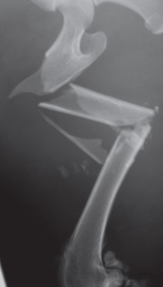
Comminuted Fractures
Two or more fracture lines communicate with each other
Often associated with;
    high-energy trauma and
    extensive soft tissue damage

Slide 12
Direction of Fracture Lines
■ TRANSVERSE: fracture line perpendicular to the long axis of bone
■ OBLIQUE: Generally, a fracture that is 1·5 to two times
longer than the diameter of the bone (or longer) is considered
oblique. The point when a short oblique fracture is classified as a transverse fracture is a unclear
■ SPIRAL: Fracture line curves around the bone (usually due to a twisting force) creating a complex three-dimensional fracture

Slide 13
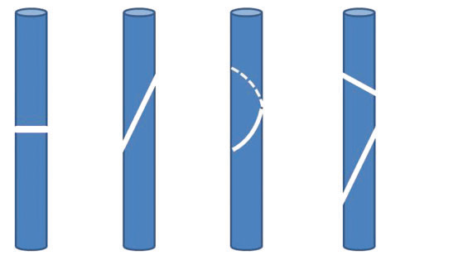
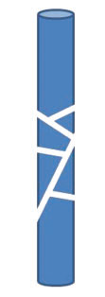

Slide 14
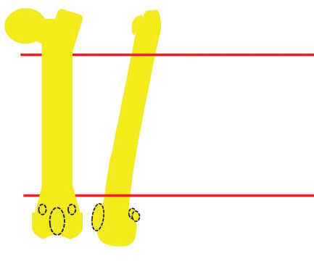
Fracture location
■ DIAPHYSEAL. Cortical bone is affected and the
fracture can be described as proximal, mid or distal.
■ METAPHYSEAL. Cancellous bone situated towards the
ends of the bones (metaphyses) has differing characteristics
of implant holding and will often heal more quickly
once stabilised than diaphyseal bone.
■ ARTICULAR. Once a joint suffers a fracture, a degree
of secondary osteoarthrosis is inevitable, but the extent
of the degeneration and effect on joint mobility can
be minimised by appropriate and prompt fracture
management.
■ CONDYLAR.

Slide 15
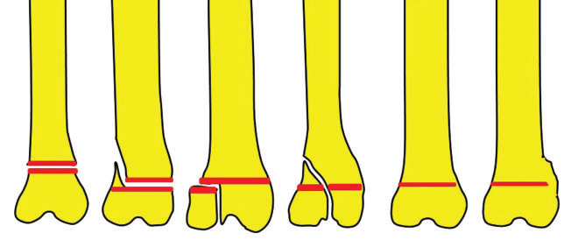
Salter Harris classification of physeal fractures
Notes:
Type I- across the physeal plate
Type II-across physeal plate and a chip of the metaphysis
Type III- through the ephysis and across the physeal plate
Type IV- through the physis and metaphysis
Type V- Crushing of the physeal plate

Slide 16
Forces acting on the fracture
AVULSION
  Consider the continued avulsion forces acting on the repair of fractures at the site of tendon or ligament insertion
IMPACTION
  Cortical bone is forced into the softer cancellous bone, usually at the end of long bones
COMPRESSION
  Cancellous bone collapses on itself; this is usually seen in vertebral body fractures

Slide 17
DISPLACEMENT
  fracture may be is minimally displaced or
  fragments are overriding
  It is usual practice to describe the direction in which the most distal fragment has moved

Slide 18
Stability
STABLE
  Interlocking fragments may have inherent stability
  Suitable for external coaptation or conservative management
UNSTABLE
  Fractures are usually unstable
  Require stabilisation to facilitate weight bearing and healing.

Slide 19
Degree of soft tissue damage
Important when deciding on a treatment approach
Neuro vascular damage can have severe implications
  for the future viability of the limb and therefore must be assessed before time and funds are allocated to fracture repair
Techniques sympathetic to severe muscle bruising can also be considered if necessary

Slide 20
Age of Fracture
Recent fractures have sharp fracture edges
Older fractures:
  fracture edges have rounded edges which form after 10 to 14 days or
  there is callus formation

Slide 21
Diagnosis
Clinical signs that may be visible include:
  Pain or localized tenderness
  Deformity or change in angulation
  Abnormal mobility
  Local swelling immediately or not until several hours or days. Persists 7-10 days
  Loss of function
  crepitus

